Slide 1
CAREER ASSISTANT
BY
C R S KARTHIK (11119A021)
K SRAVAN KUMAR (11119A052)
G KIRAN KUMAR (11119A029)

Slide 2
Abstract:
In many colleges, there is good enough communication between student and college. Students from the end of 3rd year to the passing out off college facing problems to update their profiles, to get notifications from placement cell. Even many students missing many opportunities to attend placement drives and it is quite difficult to know all this by self. So to avoid all such problems there is a digital bridge called by name “Career Assistant”.
Career Assistant is an application designed for managing placement activities and to develop a system that can be used by placement cell of a college. The purpose is to design a system that provides functionalities to perform the activities related to placement services. This system can be used as an application for the Placement cell of the college manages the student information with regards placement. In the present work some of the modules are implemented by means of managing placement data. whereas module responsible for adopting student information, company information and study material require for company placement.

Slide 3
Introduction:
All activities in the system are done by maintaining records in the format excel, word document or xml documents. For the purpose of placement drives companies are providing qualification requirements and other related documents in the format of excel, word or xml documents. It takes much time for admin to collect all such information because different companies may have different set of requirements and follow different placement drive process and also there is poor communication between students and admin. Students may not obtain the desired information. It is difficult to coordinate students, companies and interviews.
This project is aimed at developing an Mobile application for the Placement Department of the college. This System can be application for the Placement Cell of the college to manage the placement drives and the student information. Admin have access/search any information put up by Student.

Slide 4
Objectives:
The main objective of the application is to provide an interface where the admin and students communicate easily. The primary objective of the application for Placement Cell is to pass placement notifications instantly and allowing students to apply for the jobs available immediately.
The other objectives like reducing the work load of the placement cell who has to maintain all the records in a written format which becomes difficult to search and maintain which is very time consuming as well as very hectic. project provides the facility of maintaining the details of the student and gets the requested list of candidates for the companies who would like to recruit the student based on given query. The other objective is to provide easy way for students to modify their data.

Slide 5
Existing system:
Currently many colleges use the mailing system to post the updates about the academic activities. There is no analysis of student data in any college application. Student can't modify their student data themselves and if there is any updating or modification in student data, they have to inform it to placement cell and get it updated.

Slide 6
Drawbacks of the Existing system :
There is no instant communication between student and college. Size of collection of student data may be very large. To handle such a large collection of student data is a great overhead. It is very huge task to arrange student data according to various streams, match them with the companies requirement. It is a time consuming activity of managing, updating and informing speciﬁc student for speciﬁc company requirements.

Slide 7
Proposed system:
In the proposed system both Administrator and End Student easier to student with an easy interactive Student Interface. This application analyses student data in different views depending upon the student login. Student can report for any change in his academic details. Results regarding both. Analysis of student data.

Slide 8
Advantages of the Proposed System:
Communication between admin and student made easy through the application.
Reduce the paperwork and storage area.
Allow easy navigation through student data and company information.
Easy and quick analysis of student data.
Student can modify their student data themselves and if there is any updating or
modification in student data, they make data modify requests to admin and get it
updated.
Secured check in, check out and updates.

Slide 9
Architecture
Mobile Client
Server
Communication manager
Device Application Alerts
Database
Mobile Database

Slide 10
Architecture Design for Proposed System
User :- User is responsible for accessing and managing user’s data.
Server :- It allows user and admin to establish connection between them
and to exchange data.
Mobile Client :
UI :- It provides interaction between user & application.
Required Libraries :- It provides libraries required to run application
on core platform.
Core Data :- Core Data is an object graph and persistence framework .It allows
data organized by the relational entity–attribute model to be
serialized into SQL stores.

Slide 11
Module Description:
Admin Module:
The admin module has an authority to manage student data. The main student of the admin module is admin of the college. First the user should enter into the admin module of the system by entering valid user_id and password.
Admin module allows admin to add new placements events with all criteria required for placement and can upload to the system. Admin receive change requests from student and have to check & approve the modification . Admin able to change their password by using change password field. Admin can have analysis of student data and can manage the student data.

Slide 12
Student Module:
Student module is deals with information of student. Student able to access the system with their valid student name and password. Student should login into the system by entering student name and password. Student can able to update his information such as name, branch, year, aggregate marks, contact number, email, etc..
All the notifications and news uploaded by admin and each new placement notification provide with apply button for the job posted and it shows “Applied” if already applied. Profile also contains student career graphs. Settings contain the change password field and are used by the student if he needs to change his password as same in the admin module. Download tab allows student to download material uploaded by the admin. By click on the Logout, student can successfully logout from the system.

Slide 13
Database design :
Database: scsvmv_placement_app Generated by: phpMyAdmin 3.5.6 / MySQL 5.5.29 log SQL query: SELECT * FROM `dept` LIMIT 0, 30 ; Tables: 6
Table | Rows | Type | Size
dept | 8 | InnoDB | 16 KiB
notification_admin | 13 | InnoDB | 16 KiB
notification_client | 9 | InnoDB | 16 KiB
Placement | 8 | InnoDB | 16 KiB
stu_login | 4 | InnoDB | 16 KiB
ug | 657 | InnoDB | 272 KiB
6 tables | 699 | -- | 352 KiB
Database - scsvmv_placement_app

Slide 14
Testing Cases:
Black Box Testing:
Test cases are designed from an examination of the input/output values only and no knowledge of designing or coding is required.
In our project particularly, first we create the login form & then by running the form we conclude & tested that whether it runs properly or not. So such a way we perform the Unit Testing & in this way we have done the testing to all the forms.
Integration Testing:
During integration testing different modules of the system are integrated using integration plan. The integration plan specifies the steps and the order in which modules are combined to realize the full system.
In our project the Admin module, Student module were integrated & tested that the system is running properly or not. Thus with the following way we performed Integration Testing.

Slide 15
Validation:
User id & password cannot be blank while logging into the site.
In the edit profile page there are some mandatory fields like 10th_%, 12th_% , cgpa,
arrears, standing arrears, password etc., are selected using checkboxes and student
have to specify the old values and new values.
In the modify password page user have to specify the old password & the new
password.

Slide 16
Results obtained:
User can install mobile application on devices based on android/ windows Operating systems.
User can get placement notification updates.
User can manipulate his own profile with admin approval.
User can have career graphs based on their performance.
Admin can process student data using filters.

Slide 17
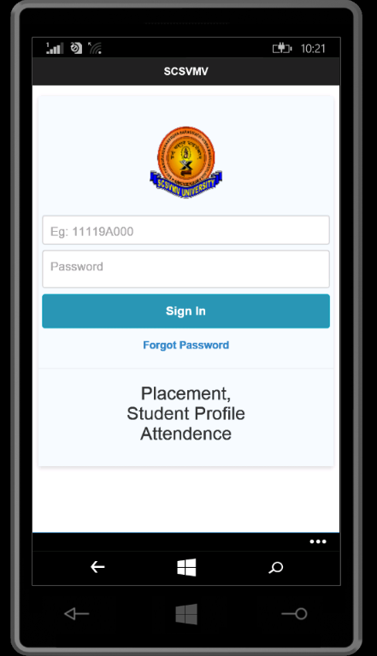
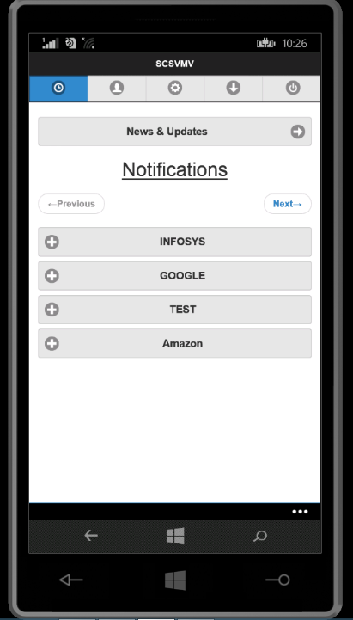
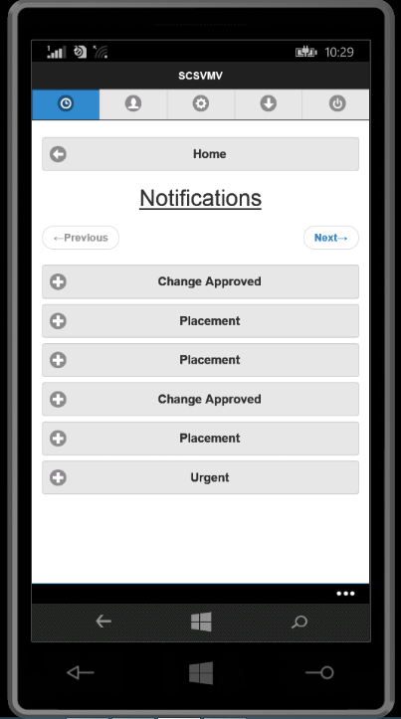
Results obtained:

Slide 18
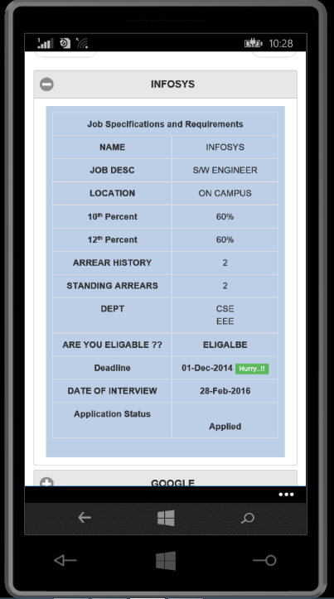
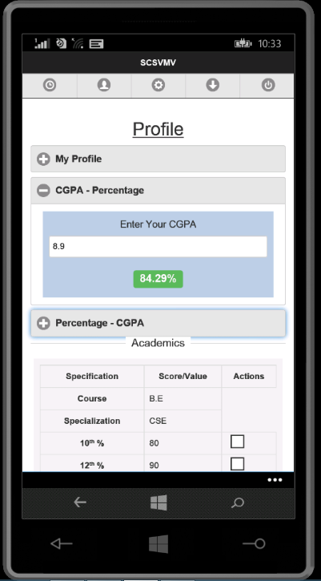
Results obtained:

Slide 19
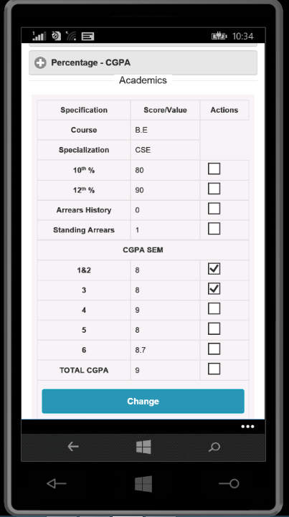
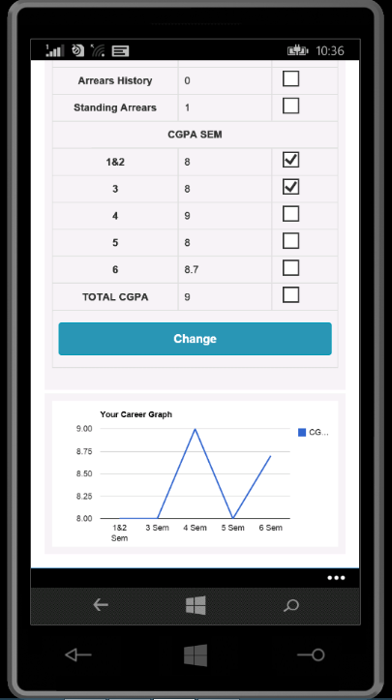
Results obtained:

Slide 20
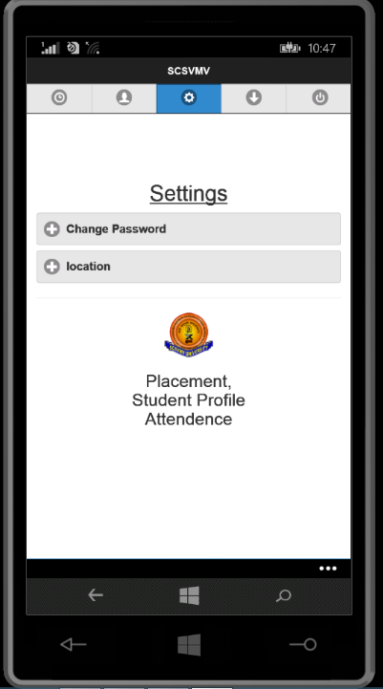
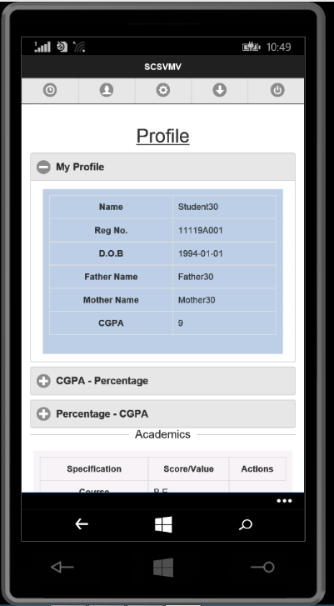
Results obtained:

Slide 21
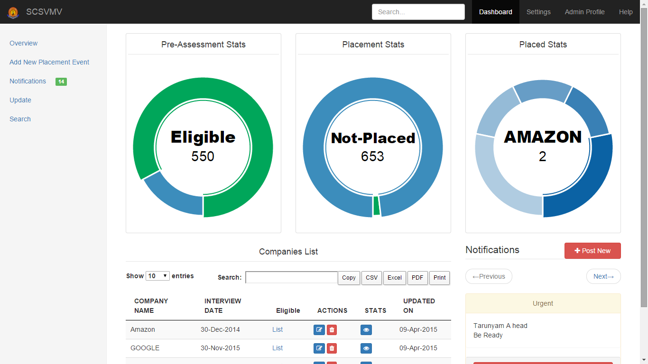
Results obtained:

Slide 22
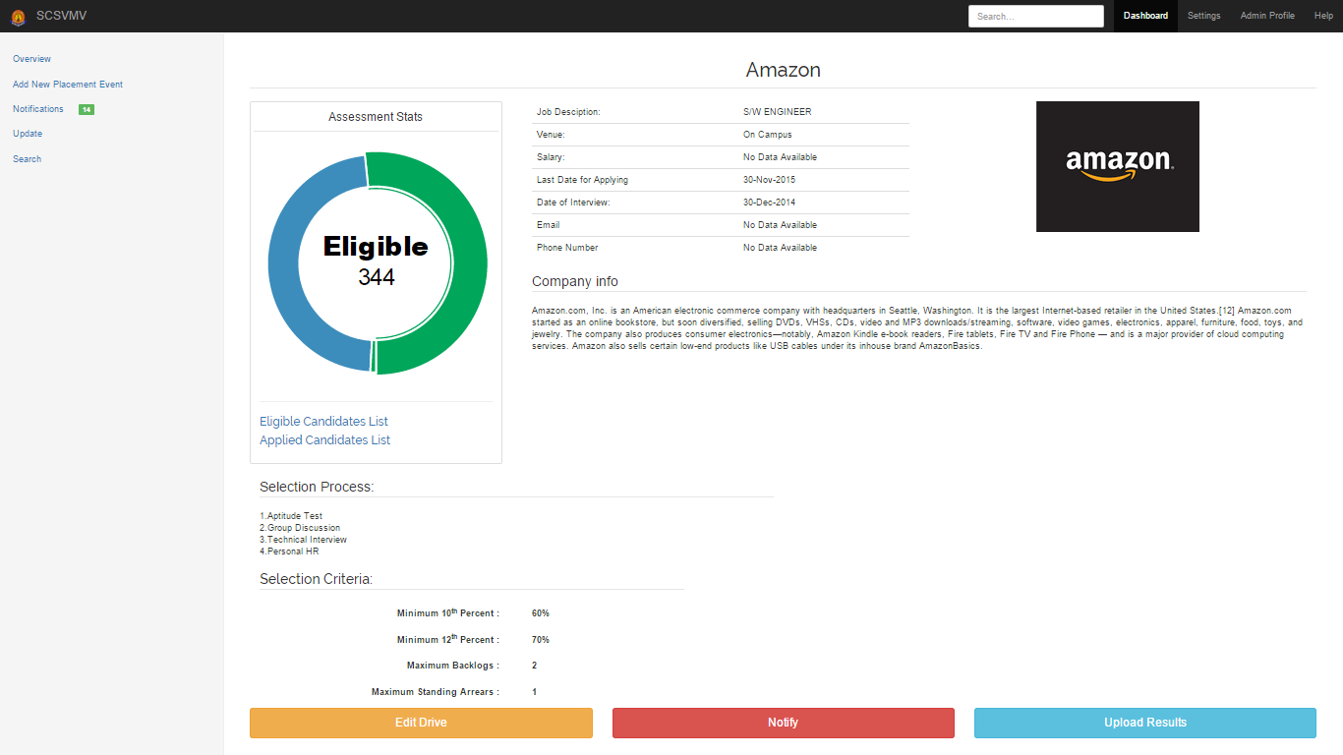
Results obtained:

Slide 23
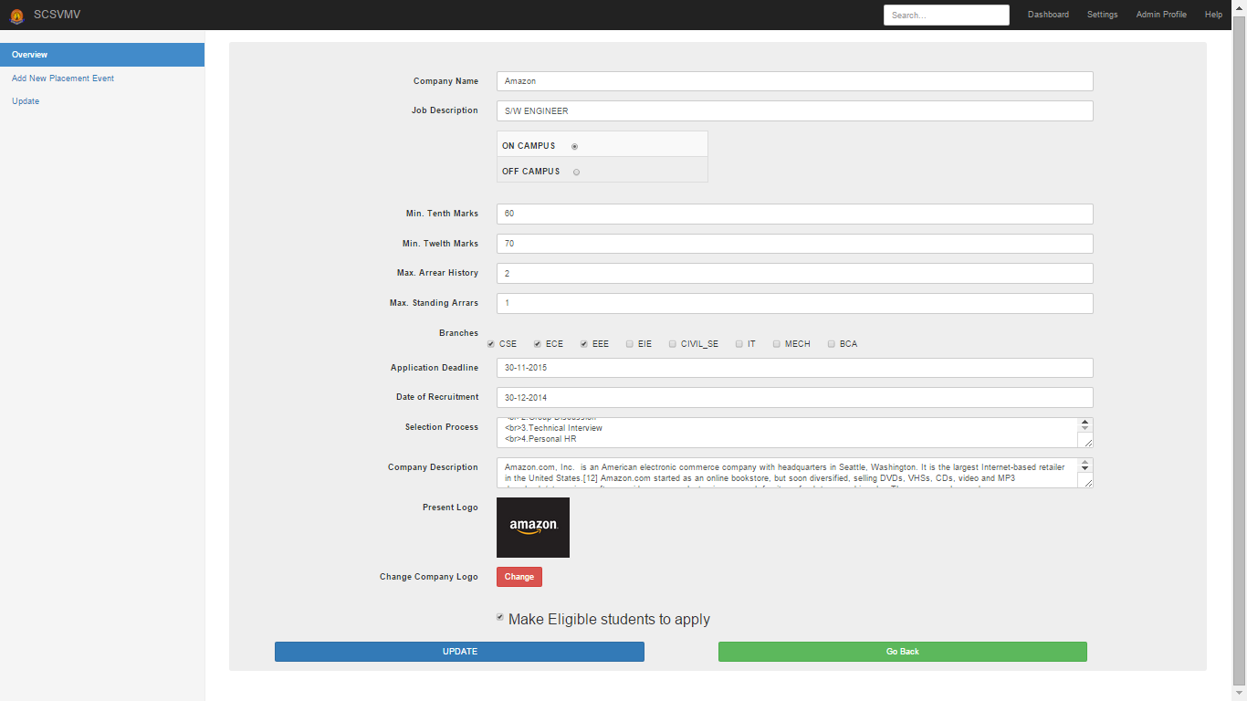
Results obtained:

Slide 24
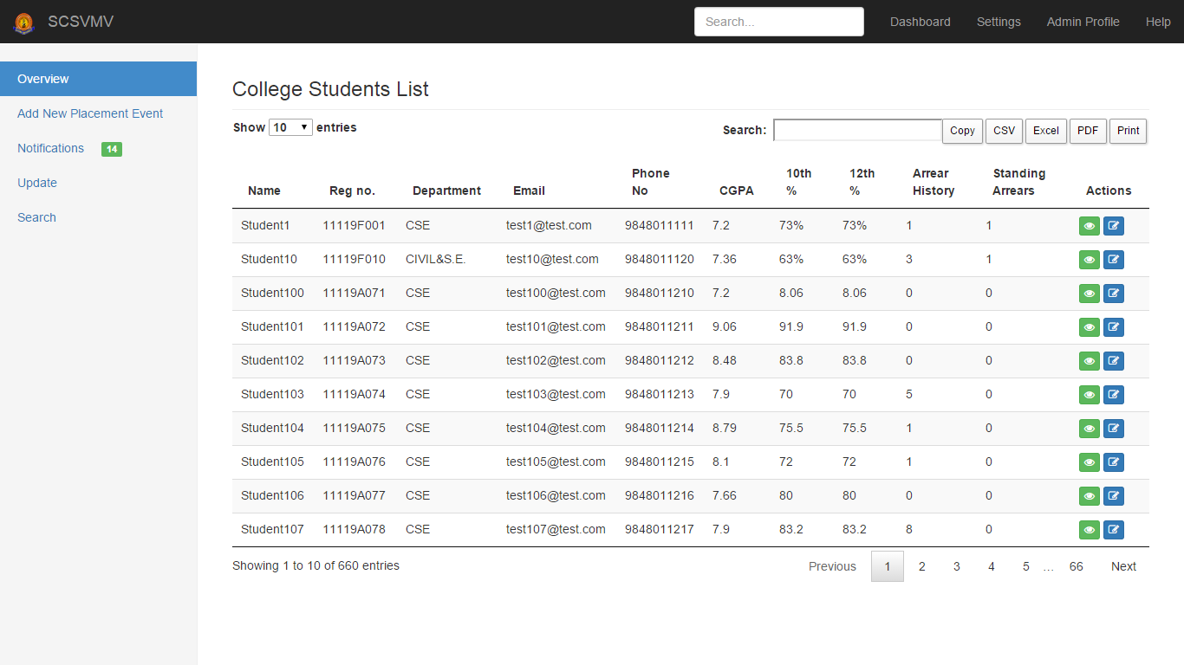
Results obtained:

Slide 25
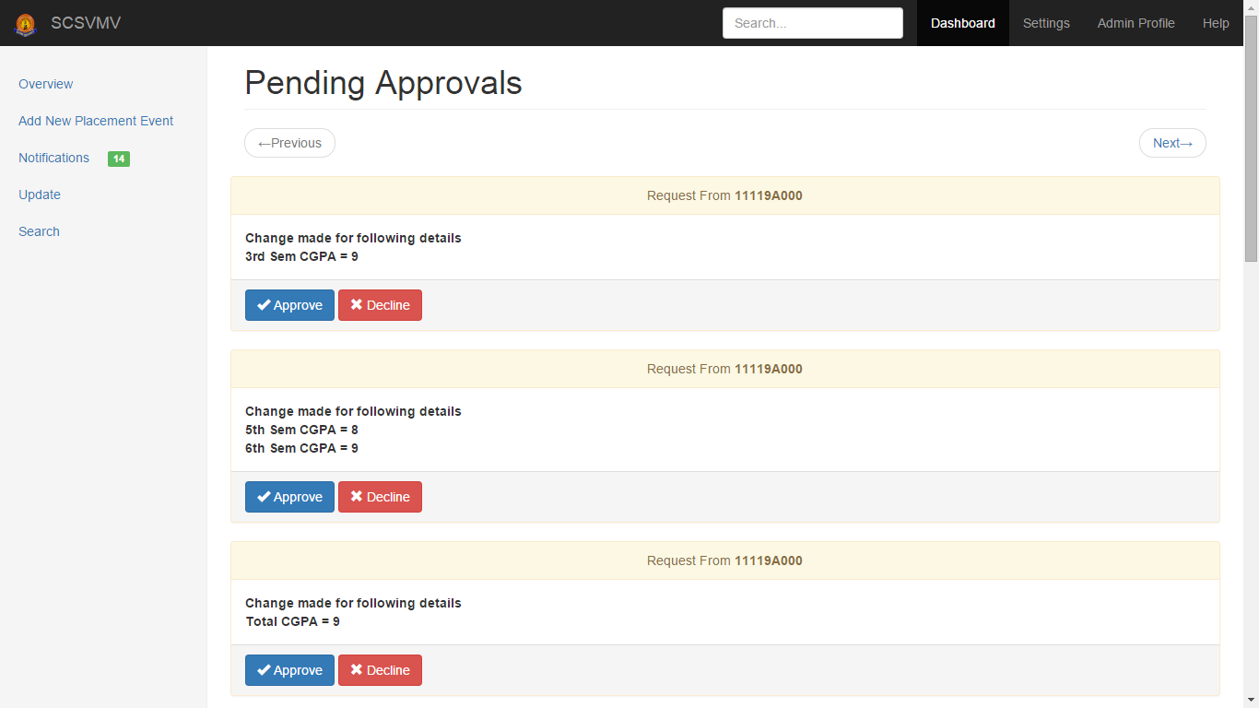
Results obtained:

Slide 26
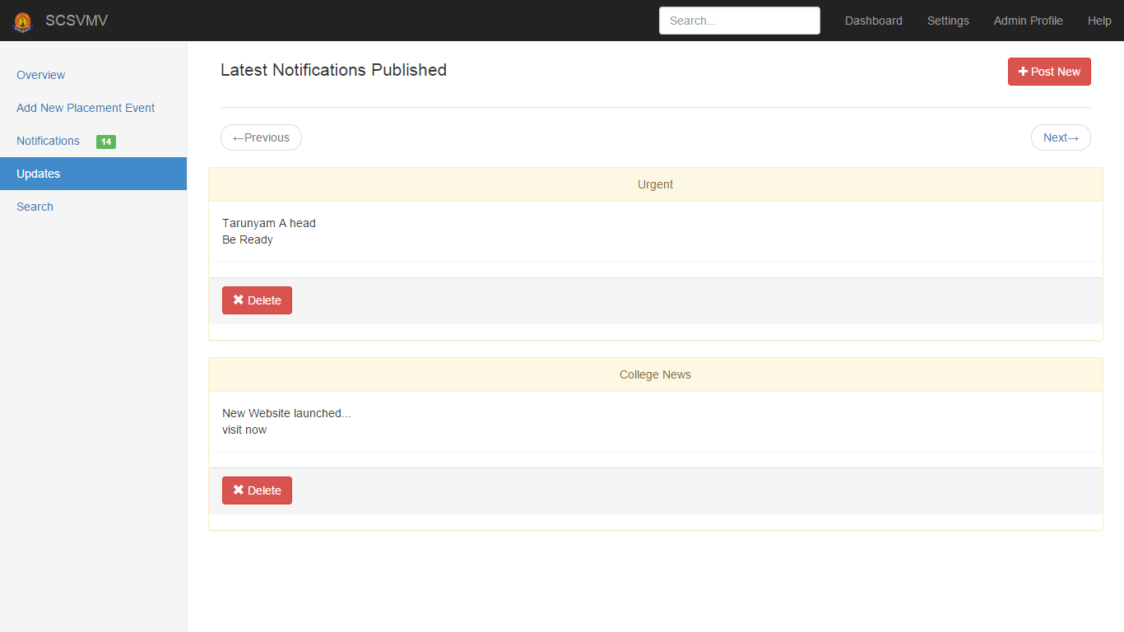
Results obtained:

Slide 27
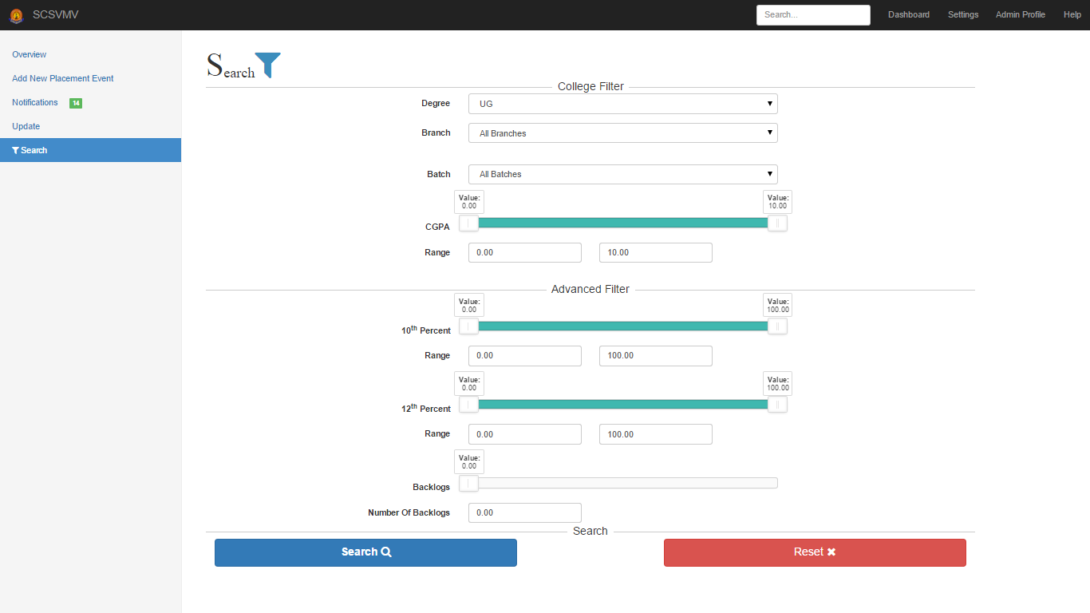
Results obtained:

Slide 28
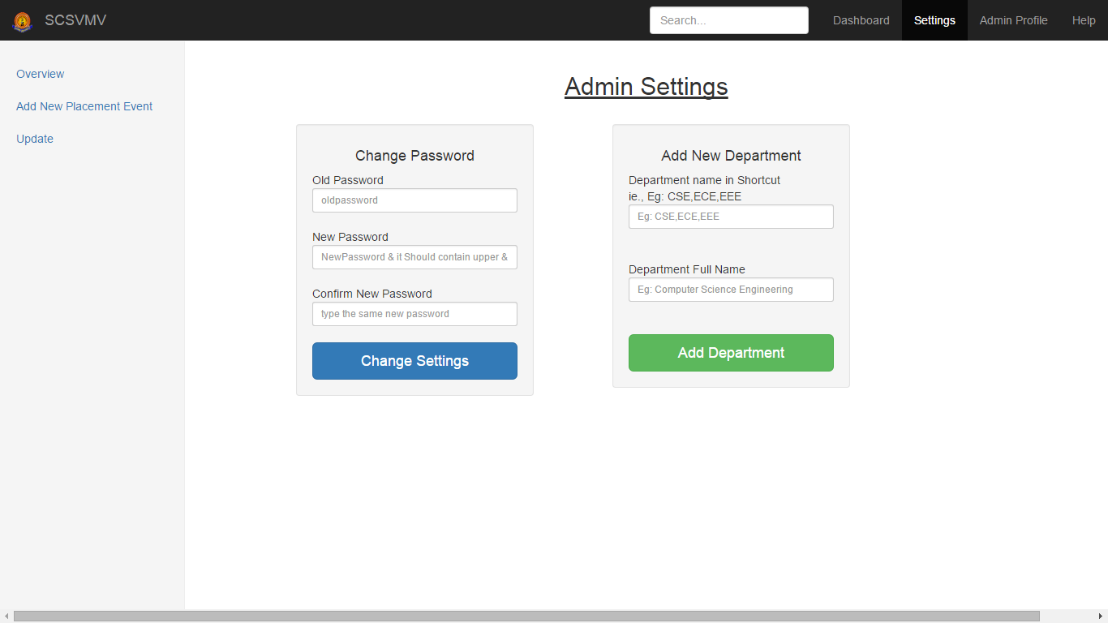
Results obtained:

Slide 29
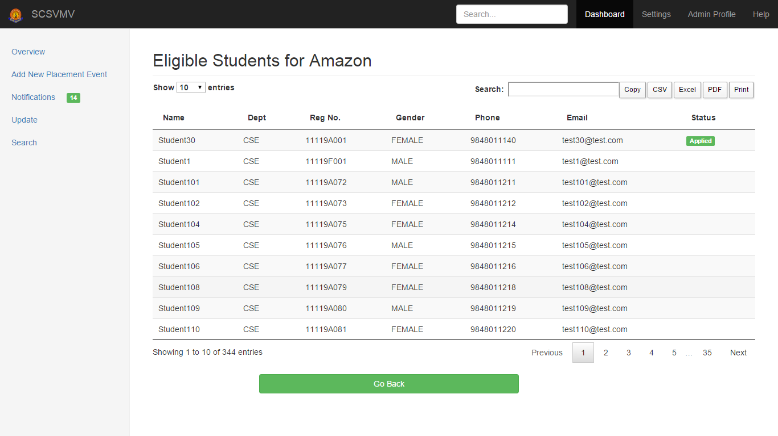
Results obtained:

Slide 30
Conclusion:
Established digital bridge for easy and instant communication between student and college through the mobile application called “Career Assistant”. The admin can see the student information and will validate it, generate the student list based on the company criteria, company details can be provided to the student and searching, sorting & update can be done and reports can be generated. Alumni data can be maintained. Overall, all the process of the placement department is automated.

Slide 31
Scope for further Development:
The system has been designed at the maximum possible excellence. The program is coded in more structured manner so we can include future enhancement. There is scope for improvement of the system. Apart from these there is scope for generating many more features. This software can be extended easily without affecting the functionality. In the future, we can place the system on the cloud so the maintenance of the data can be reduced. The exam system will integrated with the application so the student result can get directly. In between admin and company there is scope for providing interaction & to exchange data through the application.

Slide 32
Bibliography:
Murach's PHP and MySQL, by Joel Murach
MYSQL in a Nutshell, by Russell Dyer
Android Programming: The Big Nerd Ranch Guide by Bill Philips & Brian Hardy
Mysql : www.oracle-dba-online.com/sql/oracle_sql_tutorial.htm
References:
www.twitter.github.com
www.w3schools.com
www.getbootstrap.com

Slide 33
Thank You

